Slide 1

PROJECT
PREDICT LIVER DISEASE
Guided By – Varun Sir.

Slide 2

Team Member’s
Ms. Anjali Mahajan.
Ms. Shivani Dogne.
Ms. Mamta Patil.
Mr. Amey Kumbhar.
Mr. Kunal Shinde.
Mr. Om Gorantiwar.

Slide 3

BUSINESS OBJECTIVE
The variable to be predicted is categorical
(no disease, suspect disease, hepatitis c, fibrosis, cirrhosis).
Therefore, this is a classification project.

Slide 4


Project Flow-
EDA
Model building
Model Evaluation
Deployment
Final Presentation

Slide 5
DATA DESCRIPTION
The number of instances (rows) in the data set is 615, and the number of variables (columns) is 13. Nearly all input variables are numeric-valued except one, Sex, which is binary, and most of them represent measurements from blood and urine analysis. The following list summarizes the variables information:
Category
Age
Sex
Albumin
alkaline_phosphatase
alanine_aminotransferase
aspartate_aminotransferase
Bilirubin
Cholinesterase
Cholesterol
Creatinina
gamma_glutamyl_transferase
protein

Slide 6
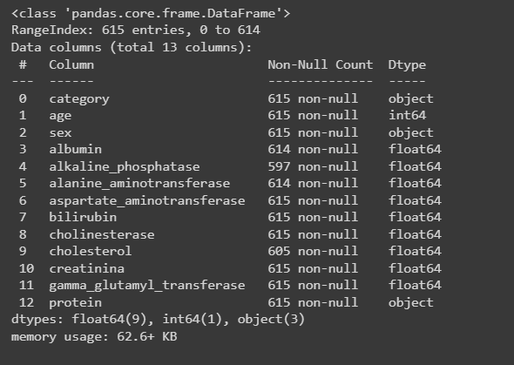
Data.info()

Slide 7
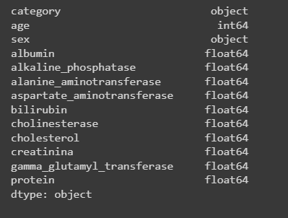
Data.types()

Slide 8
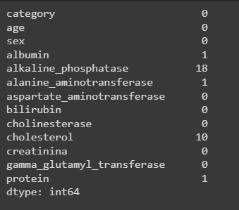
Data Cleaning
Data.isnull()

Slide 9
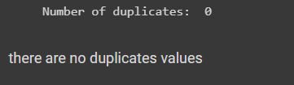
Checking for duplicates values
Data.duplicates()

Slide 10
Auto eda
Using AutoViz_Class

Slide 11
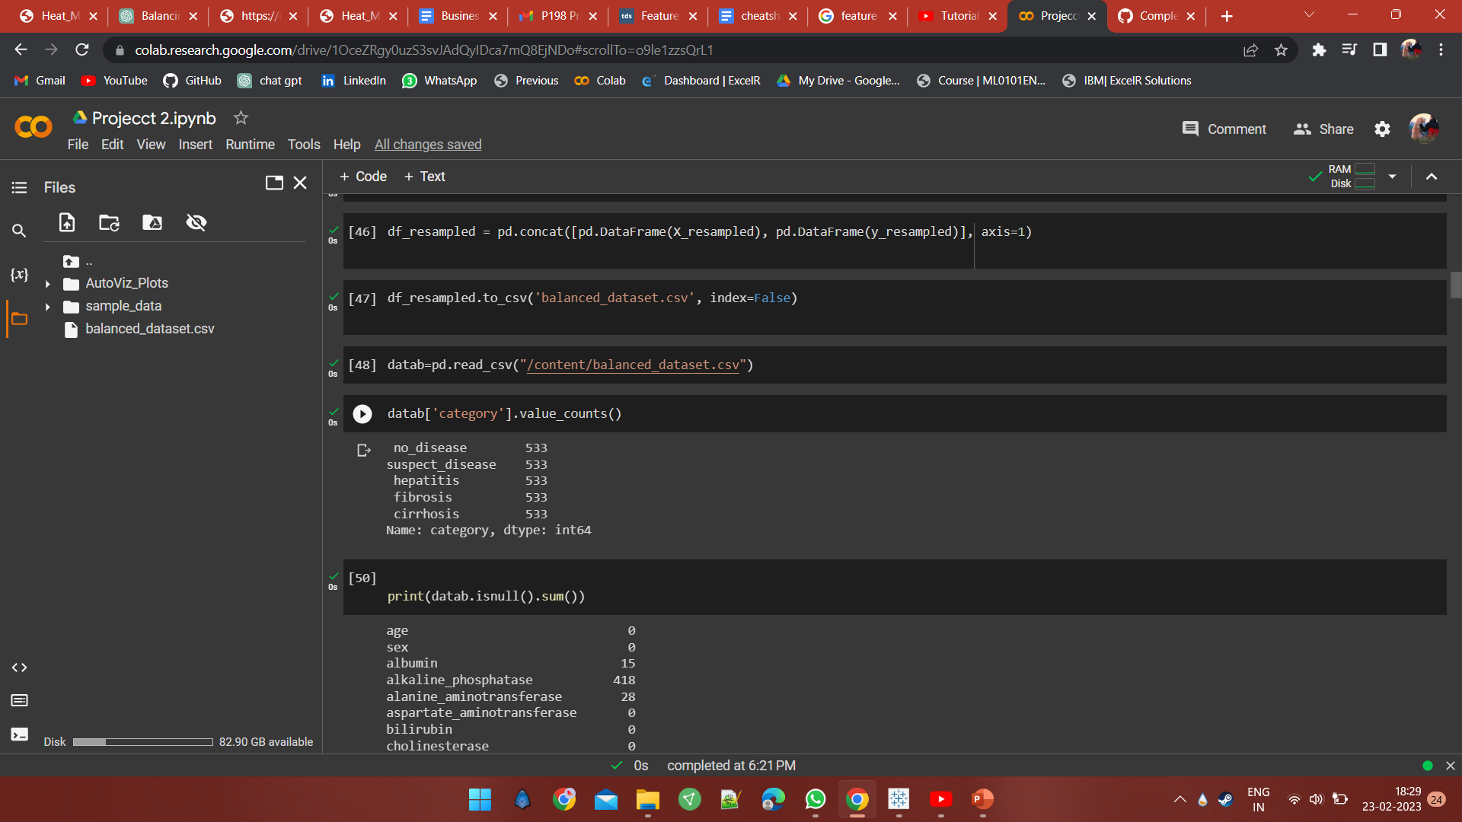
Data balancing

Slide 12
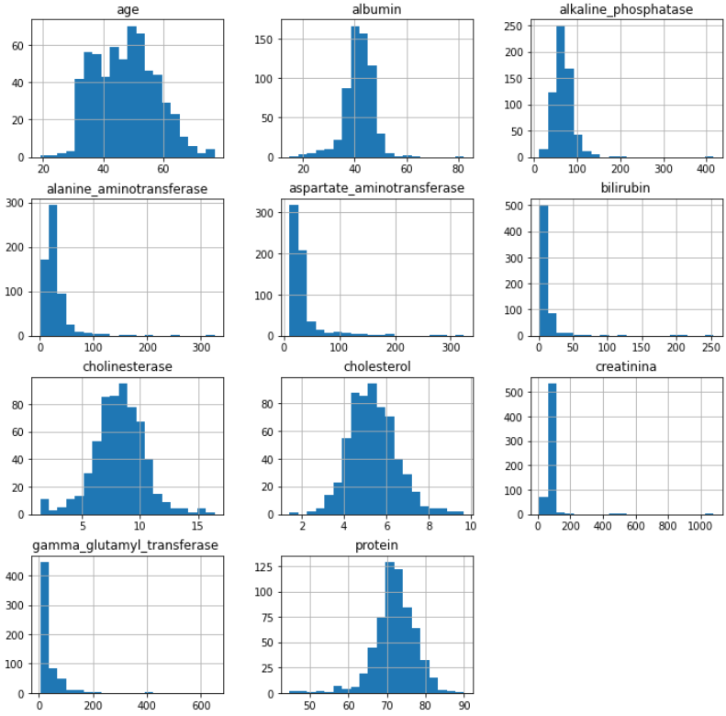
Visualization
Data.hist()

Slide 13
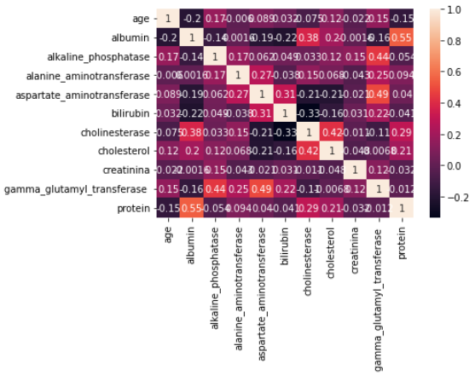
Correlation Matrix
sns.heatmap()

Slide 14
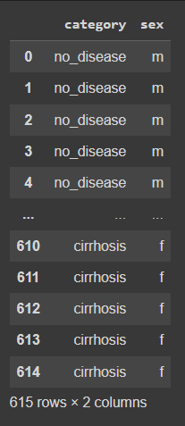
Separating of non-numerical
and numerical values
data.select.d_types()
*Selecting numerical features

Slide 15
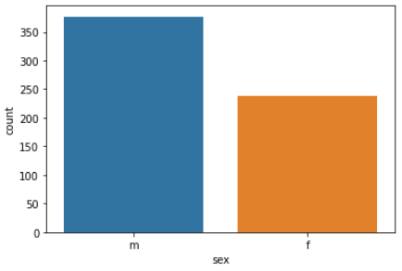
Distribution of target variables
sns.countplot()

Slide 16
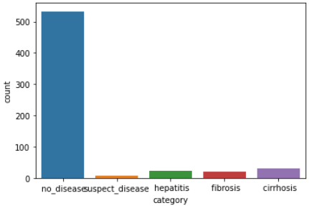
Distribution of target variables
sns.countplot()

Slide 17
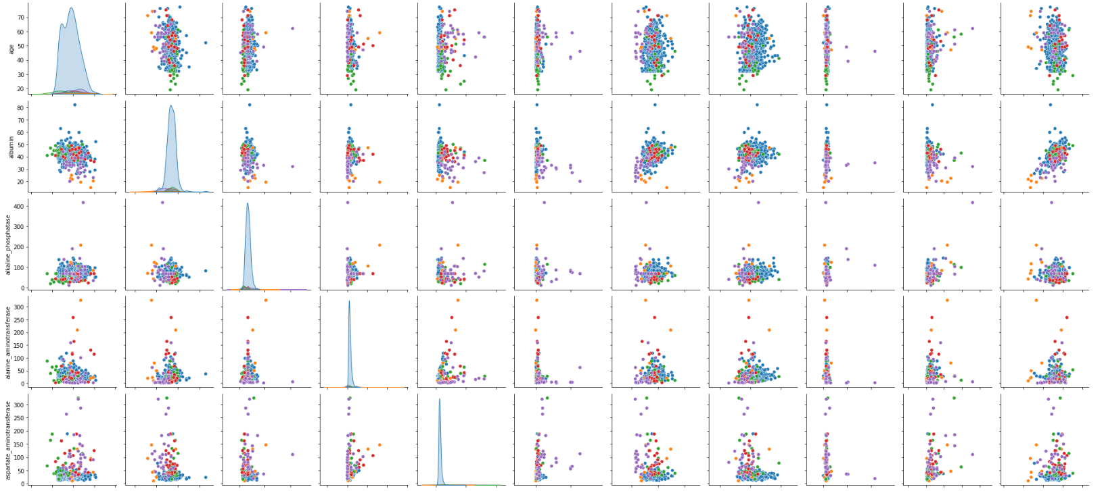
Multivariate analysis
sns.pairplot()

Slide 18
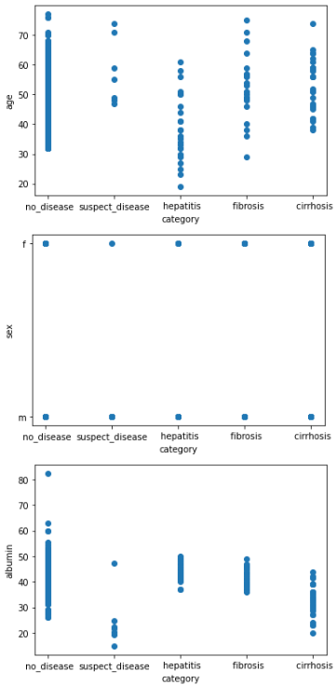
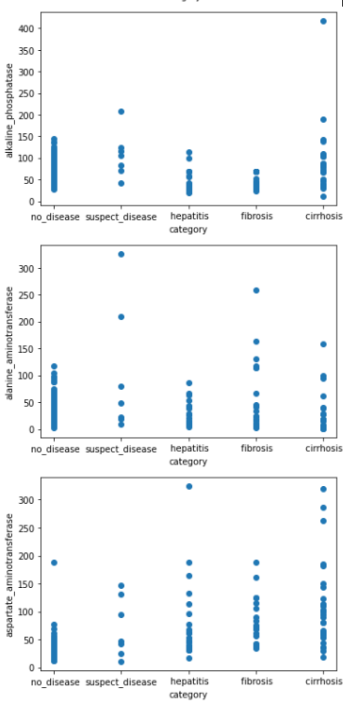
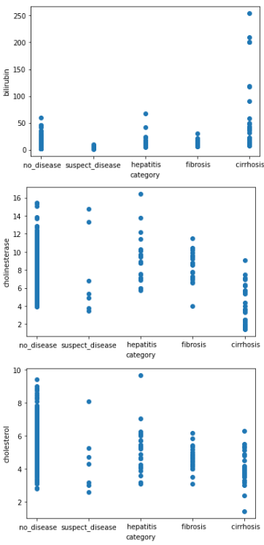
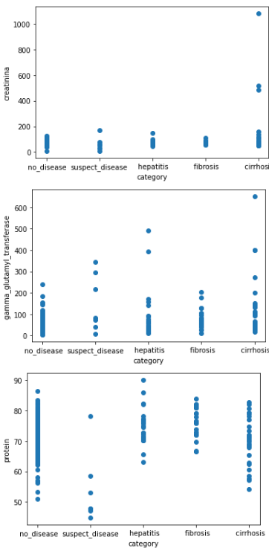
Creating multiple scatterplot
plt.scatter()

Slide 19
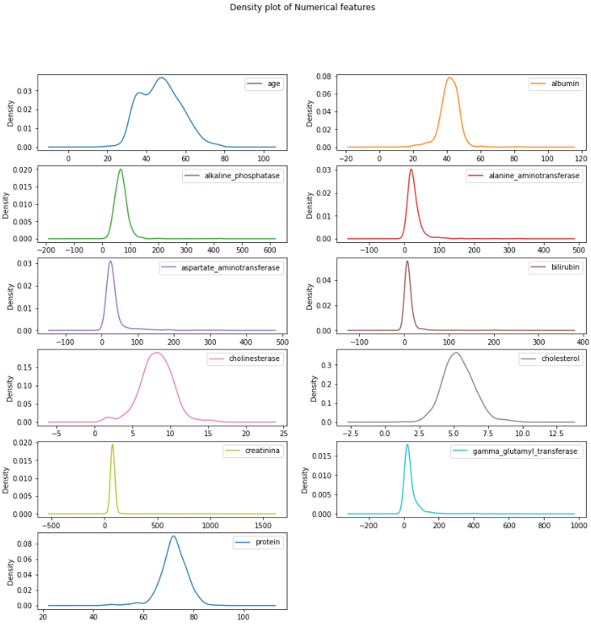
Density plot of Numerical features

Slide 20
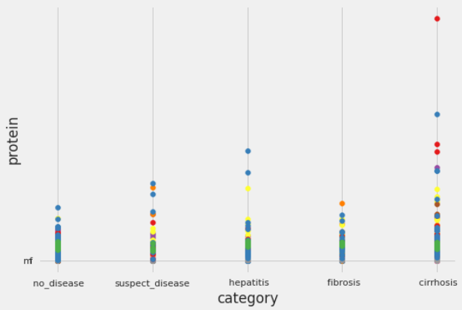
multiple scatterplots

Slide 21
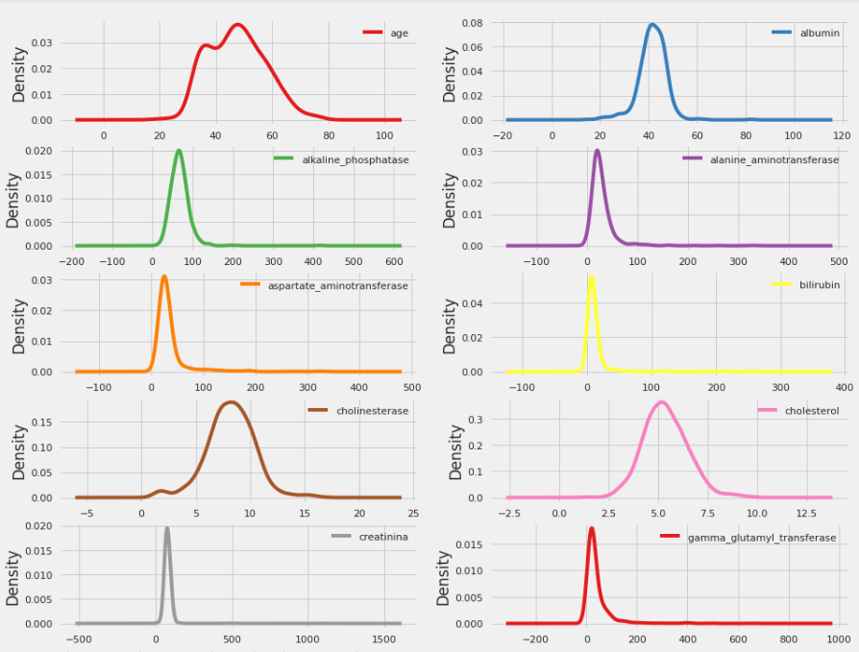
Density plot of Numerical features

Slide 22
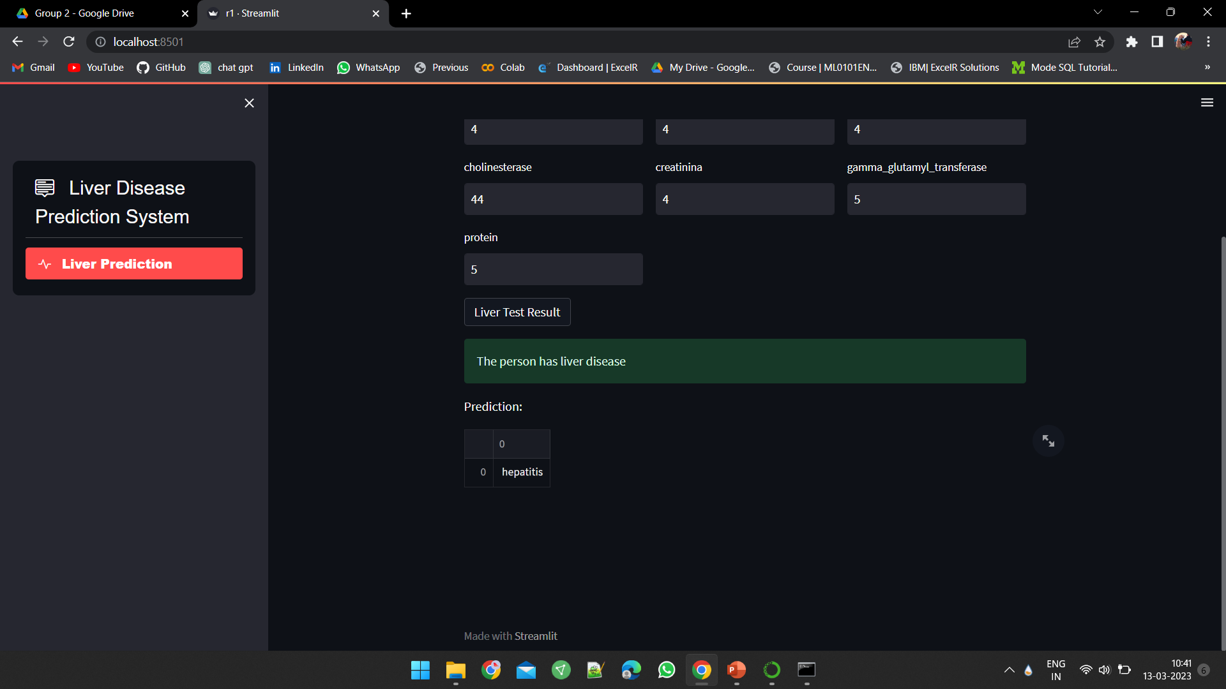
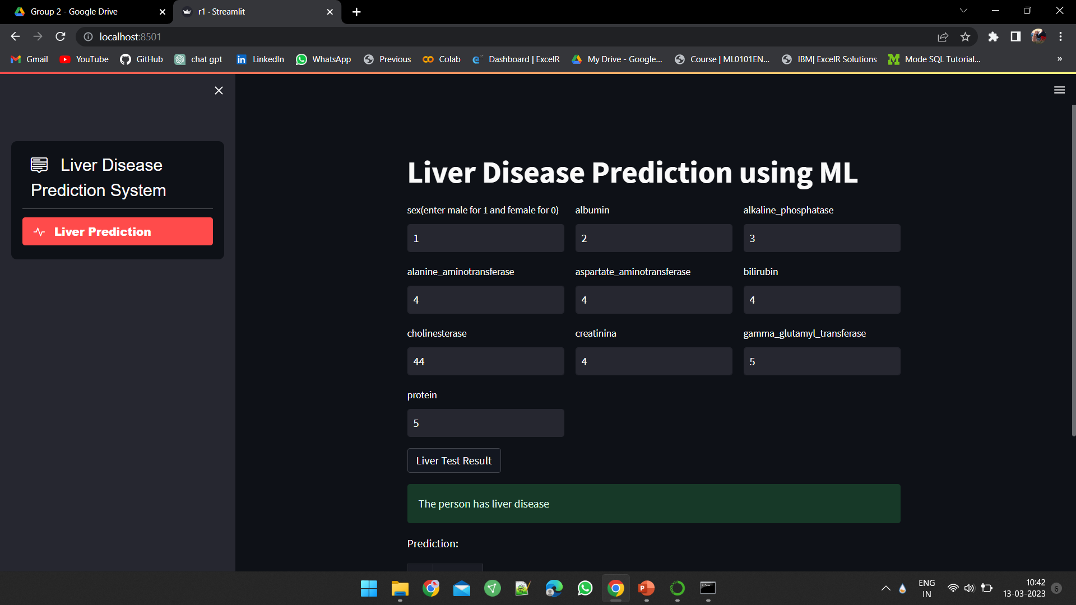
Model deployment

Slide 23
Challenges we faced
Data preprocessing were challenging to use
How we come over it?
To address this challenge, used techniques like imputation to fill in missing data,. also we consider using outlier detection techniques to identify and remove outliers.

